Slide 1
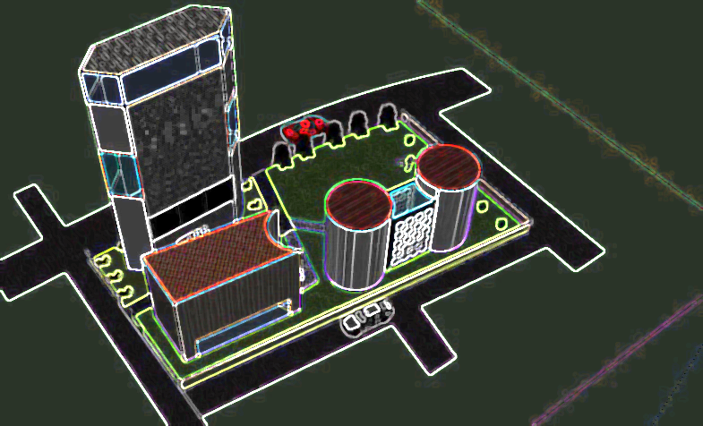
Group Design – Principal Tower
By Group 4

Slide 2
Contents Page
Client Requirements
Constraints
Masterplan
Schemes Proposed
Tower Location
Proposed Scheme 1
Proposed Scheme 2
Proposed Developed Design
Winter Garden
Lateral Stability
Load Path/Take Down
Sustainability
Health & Safety
Short Summary

Slide 3
Client Requirements
Protected view
Area requirements
Must be iconic by defining London’s skyline
Mechanical and Electrical (M&E) clearance of 600mm
BREEAM - Aim at Outstanding, minimum acceptable Excellent
Winter Garden (will be discussed in further detail on slide 11)

Slide 4
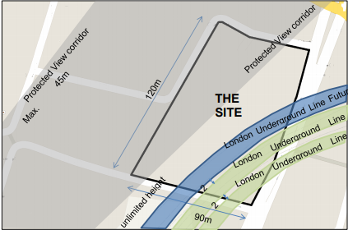
Constraints
The following constraints had an impact on the design of the project:
The underground tunnel
Protected view corridor
Must be built within the site boundary
Noise (35dB)

Slide 5
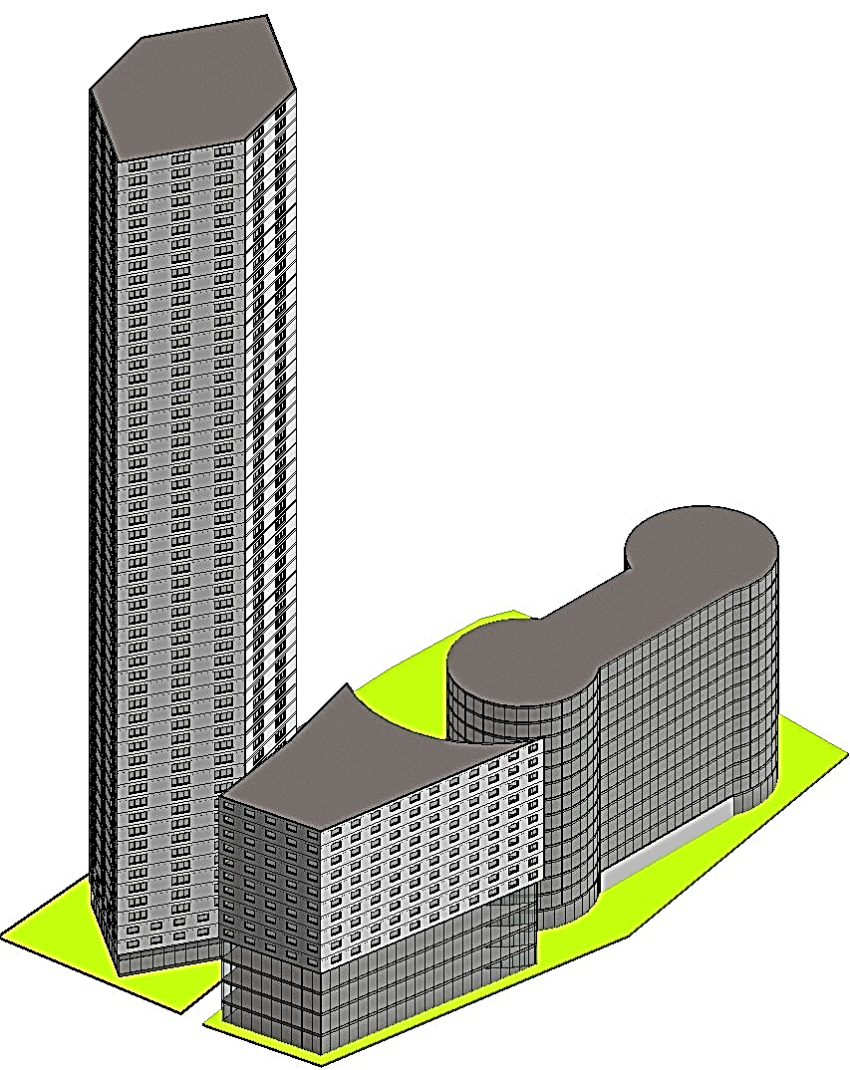
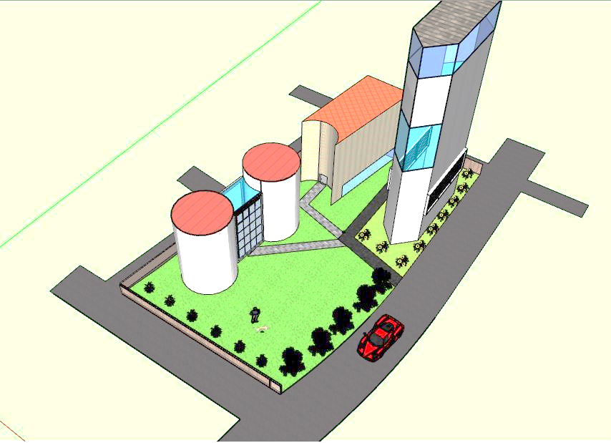
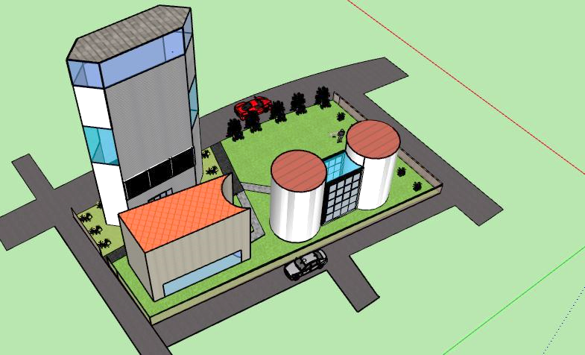
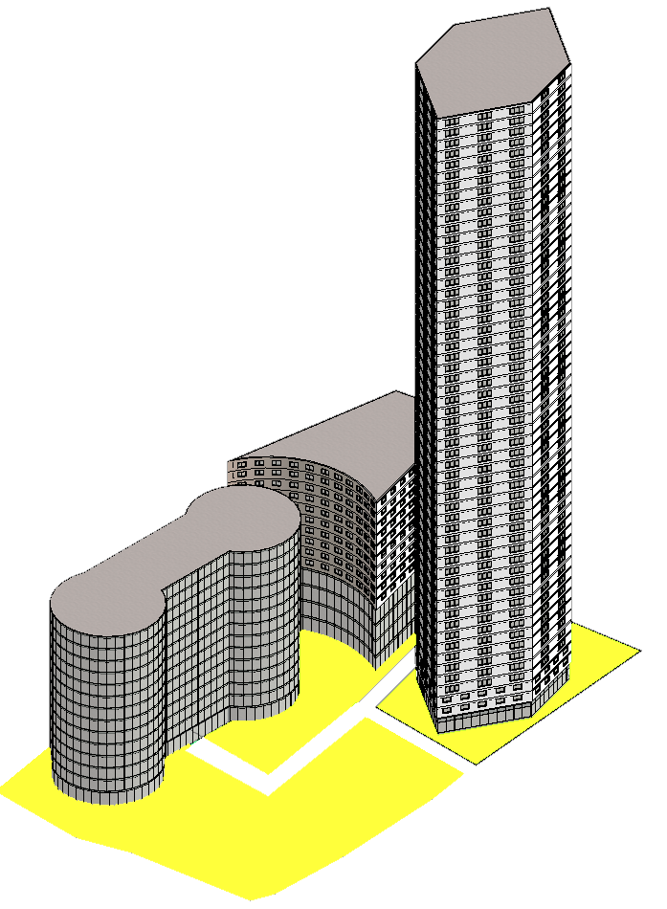
Masterplan
The masterplan consists of 3 mixed-use buildings containing residential, affordable housing, offices, retail and landscape.
Innovative design had been created for the masterplan by using Google Sketchup & Autodesk Revit in order to grab the clients interest.

Slide 6
Schemes Proposed
Conceptual design comprising of two proposed design of the tower:
Scheme One (Recommended)
Scheme Two (Other possible scheme)

Slide 7
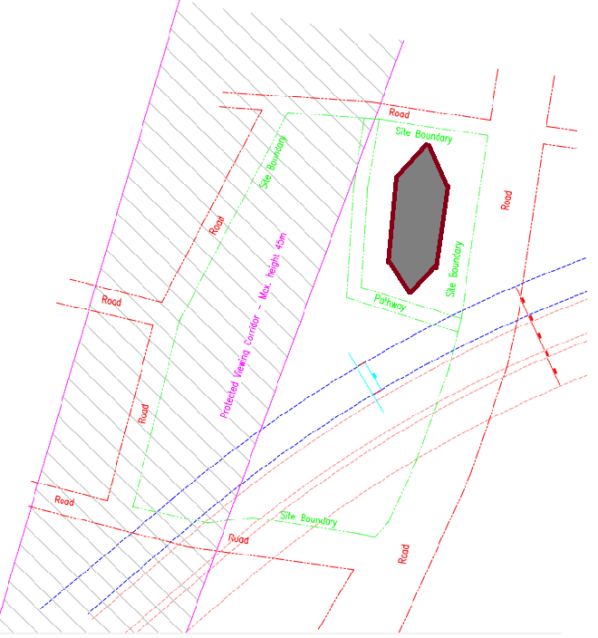
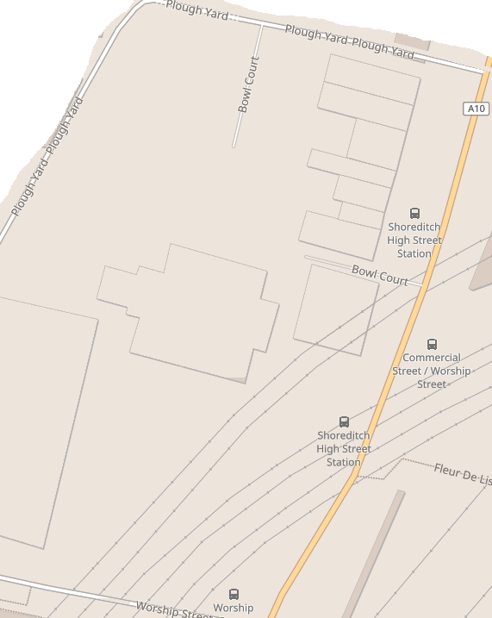
Tower Location
Real world site location
Our tower location
Site situated between Worship Street & Shoreditch High Street
Tower is located in the site boundary, outside the underground area zone.

Slide 8
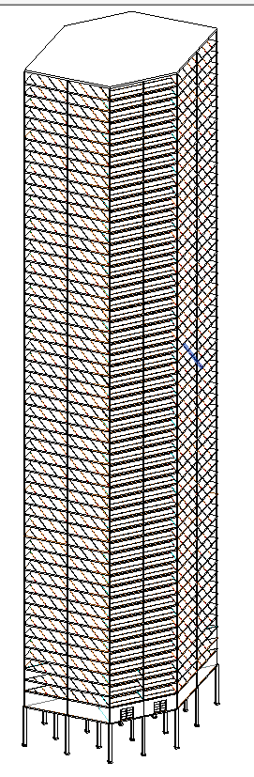
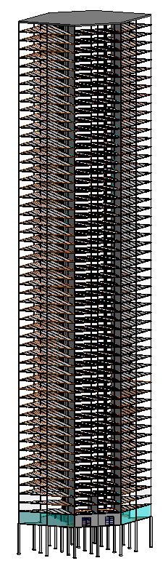
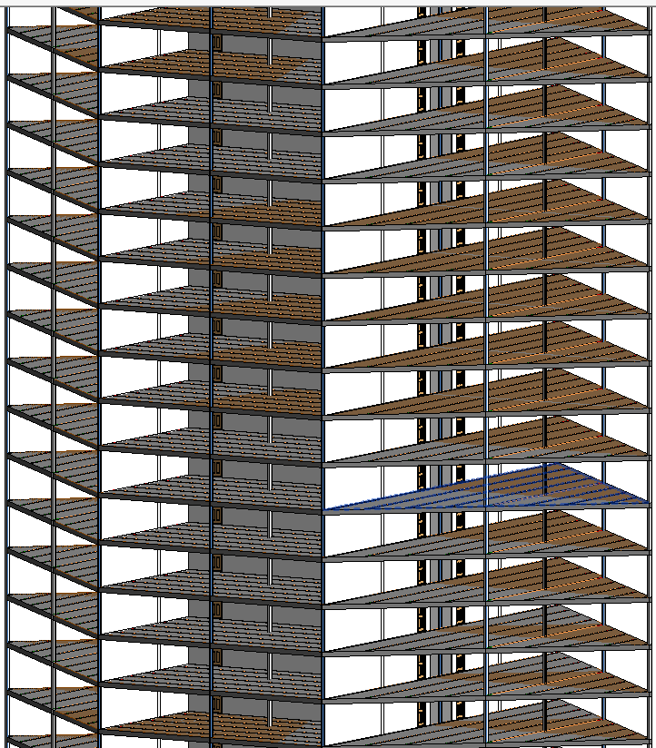
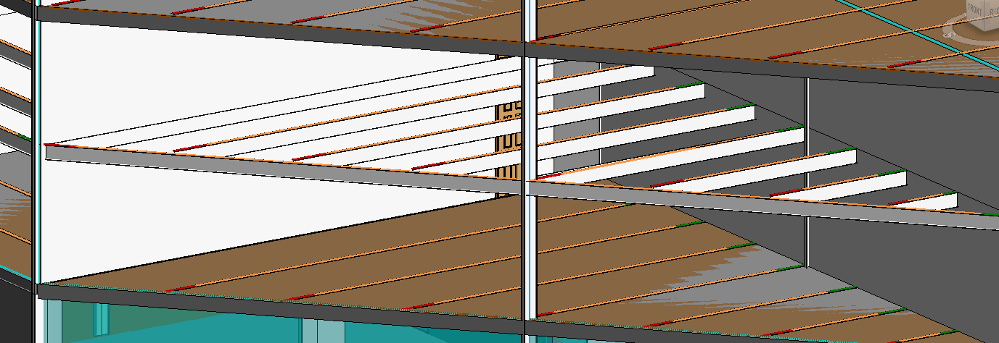
Proposed Scheme 1
Scheme 1– Steel Frame
Concrete core with structural steel framing
Bracing
Fireproof
Good under tension
Weak in compression

Slide 9
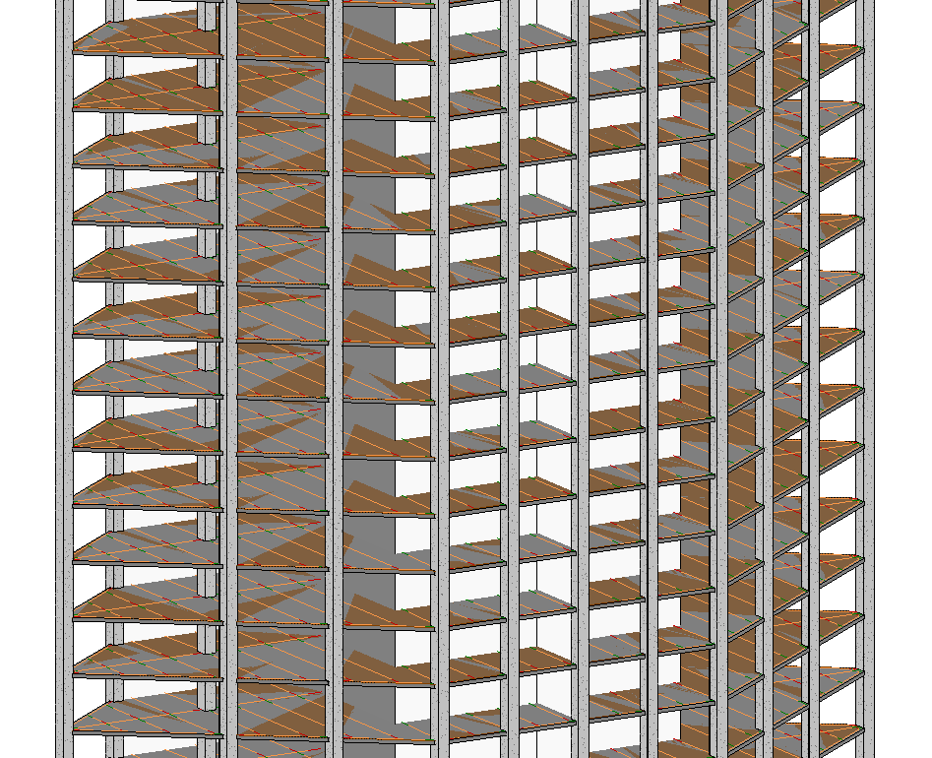
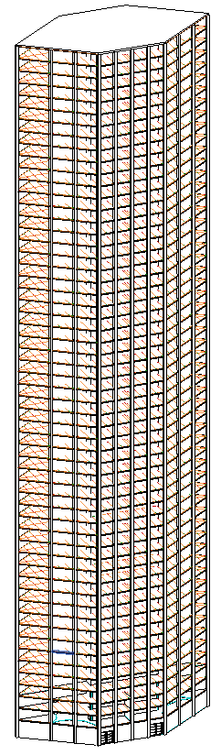
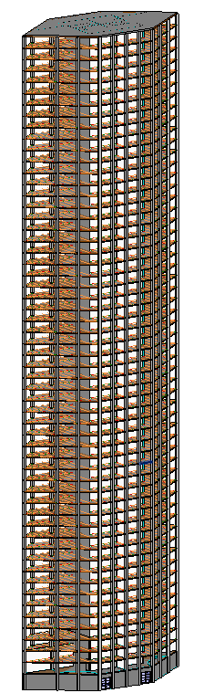
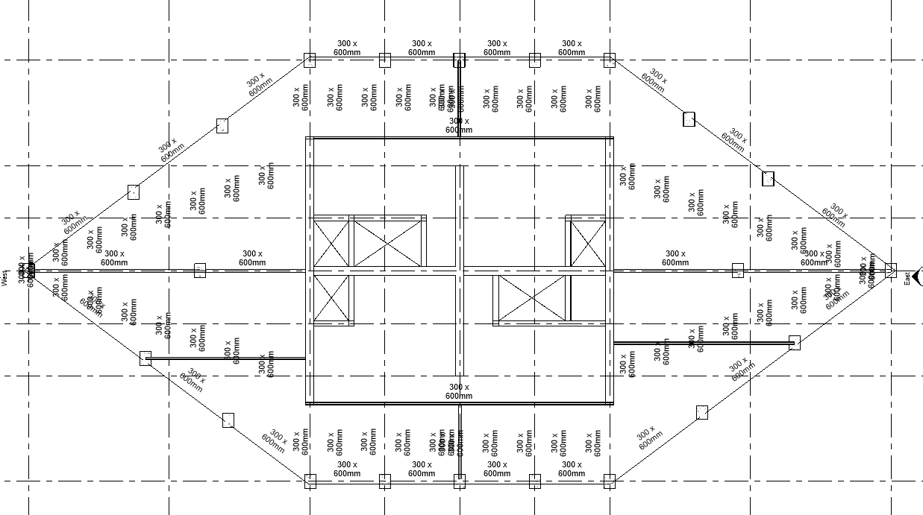
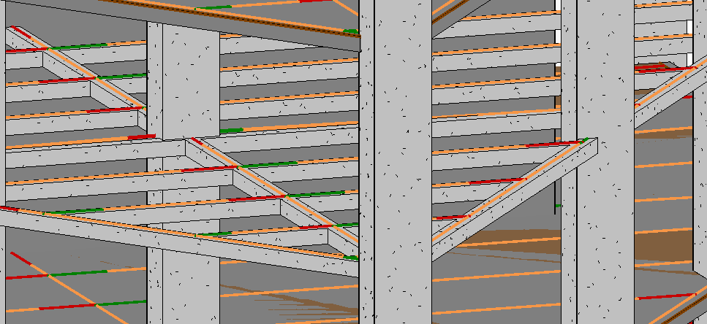
Proposed Scheme 2
Scheme 2 – Concrete Frame
Concrete core with structural concrete framing
Fireproof
Good under compression
Weak in tension

Slide 10
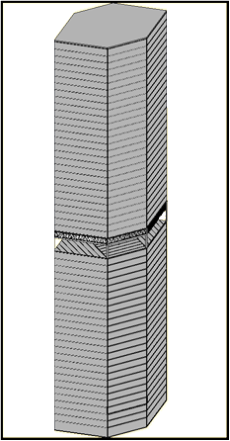
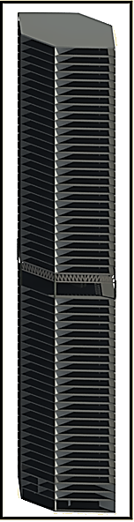
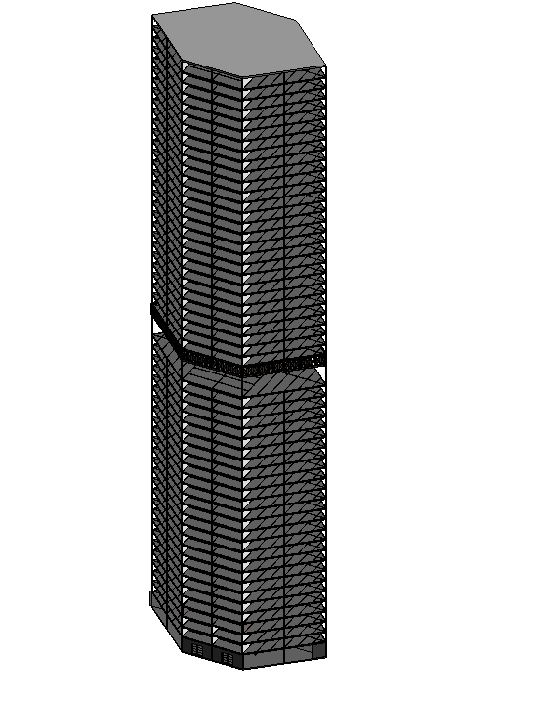
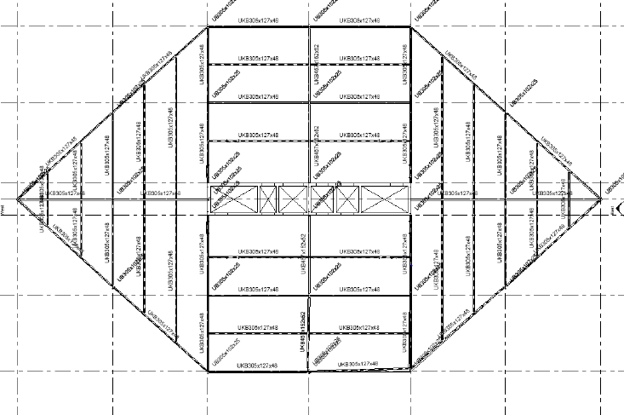
Proposed Developed Design
Final design geared to amaze the client!

Slide 11
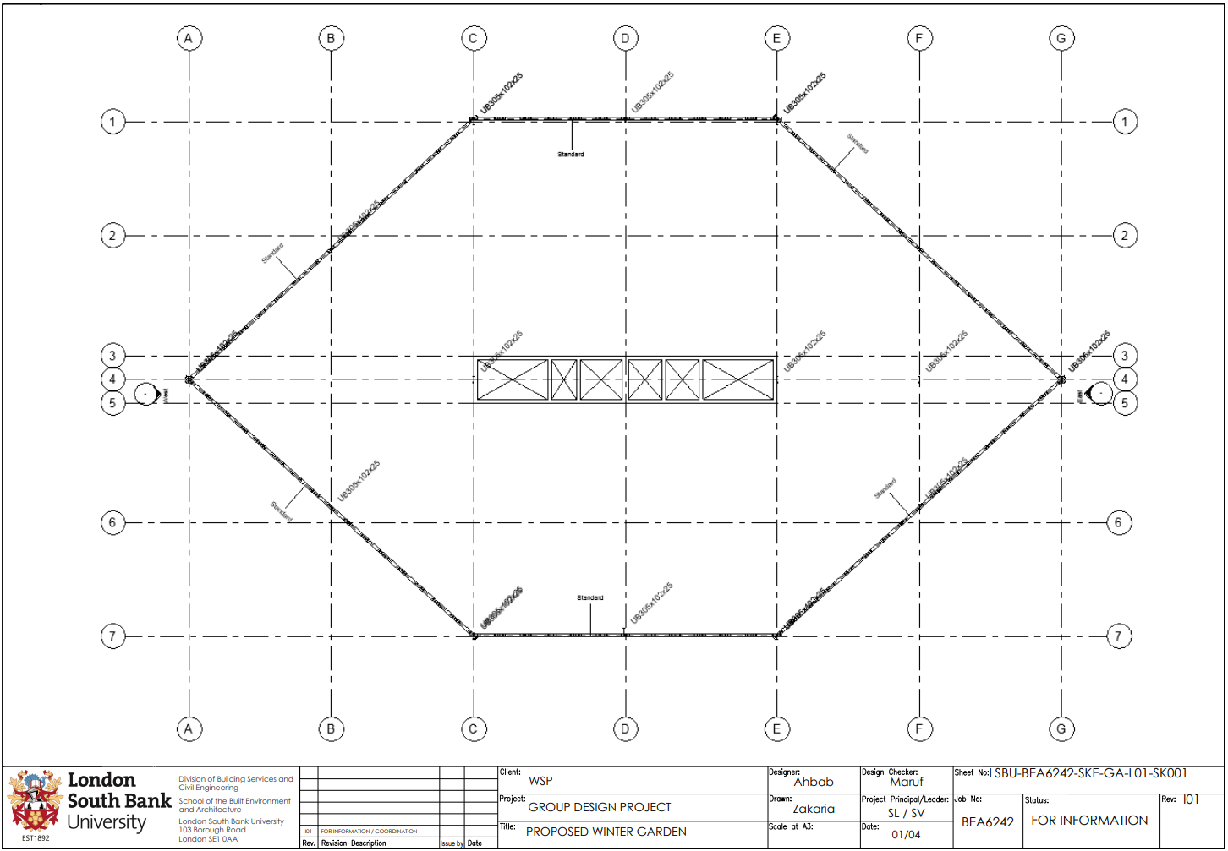
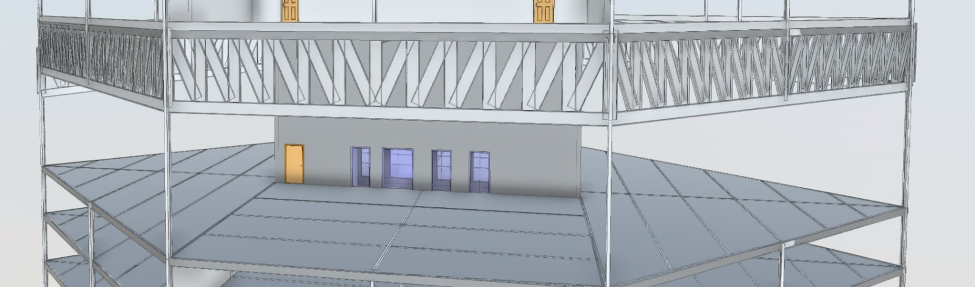
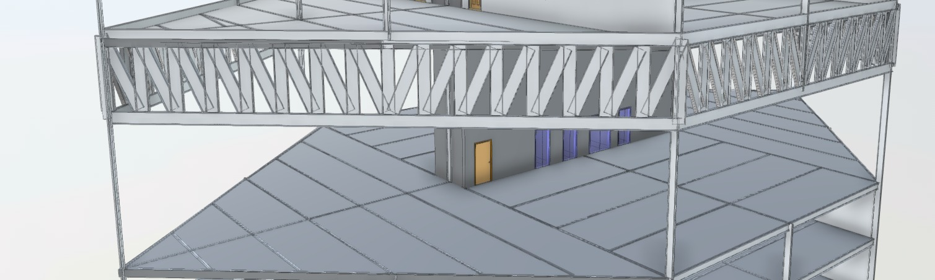
Winter Garden (Additional requirement)
Clients requirement met by proposing the following:
Removed all internal columns
Spread over three floors
Garden area/Open space – residents only
Reduced some external columns
Truss system implemented

Slide 12
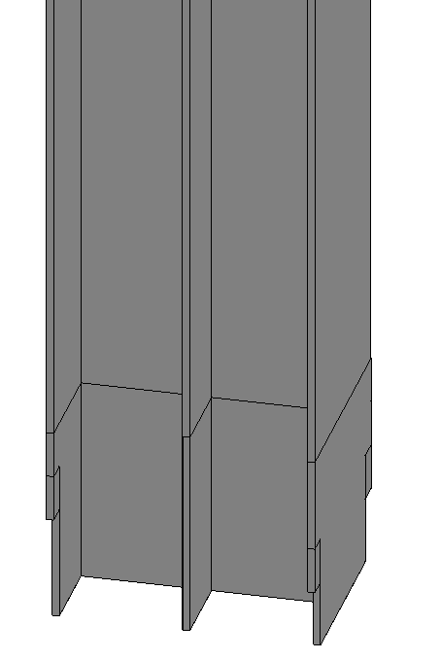
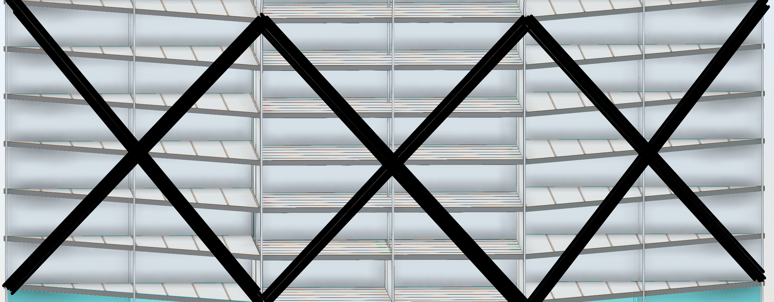
Lateral Stability
Lateral stability needs to be taken into consideration especially if the highest point of the building is measured at 155m:
Cross bracing
Concrete core

Slide 13
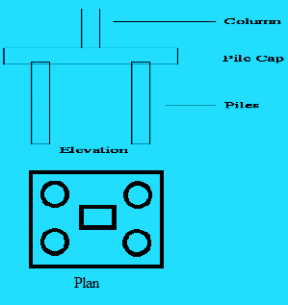
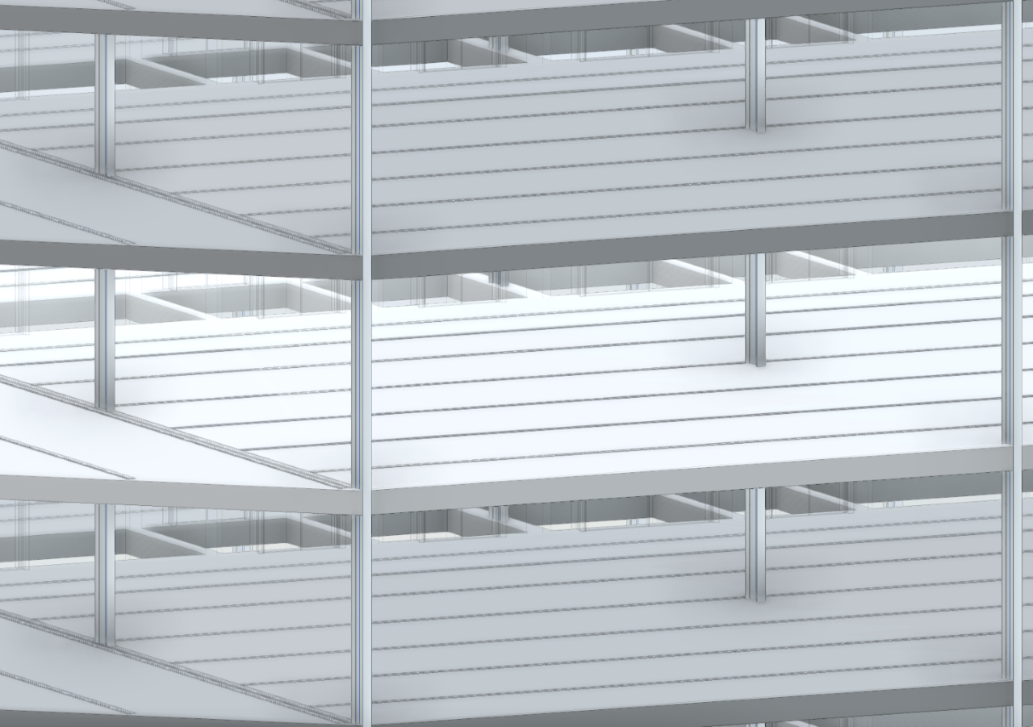
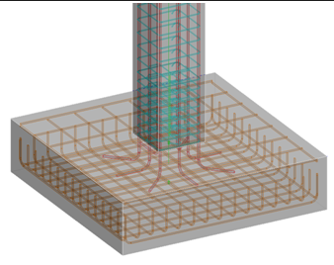
Load Path/Take down
Load path needs to be considered as it’s a 57 floor high rise building:
Slab to Beams (Primary/Secondary)
Beam to Column
Column to Pile Cap
Pile cap to Piles

Slide 14
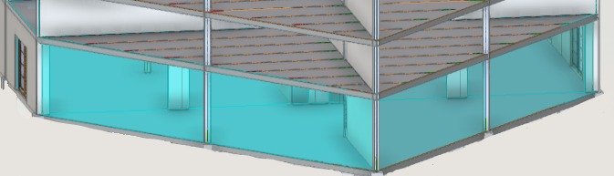
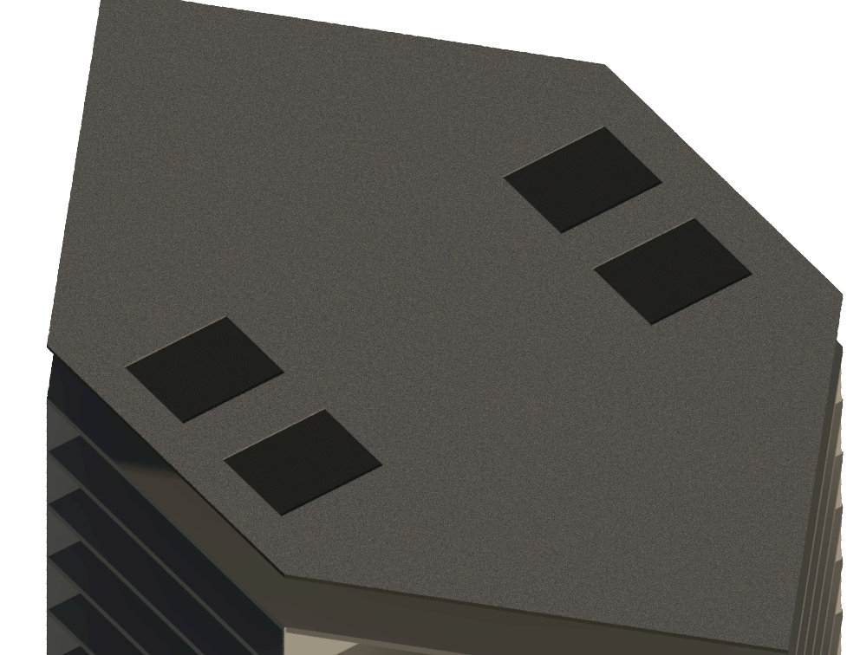
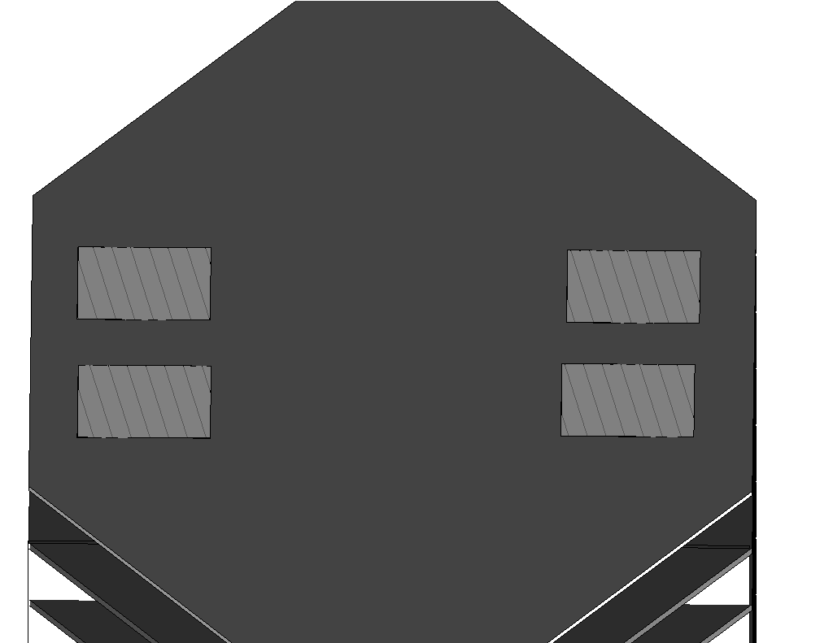
Sustainability
Client is committed to reduce carbon footprint so we’ve taken the following in to consideration:
Aiming for BREEAM level of excellent
Double glazed energy efficient curtain walls
Use of recycled materials
Use of cement replacements (PFA,GGBS..etc)
4 Solar panels at roof level (+155m AOD)

Slide 15
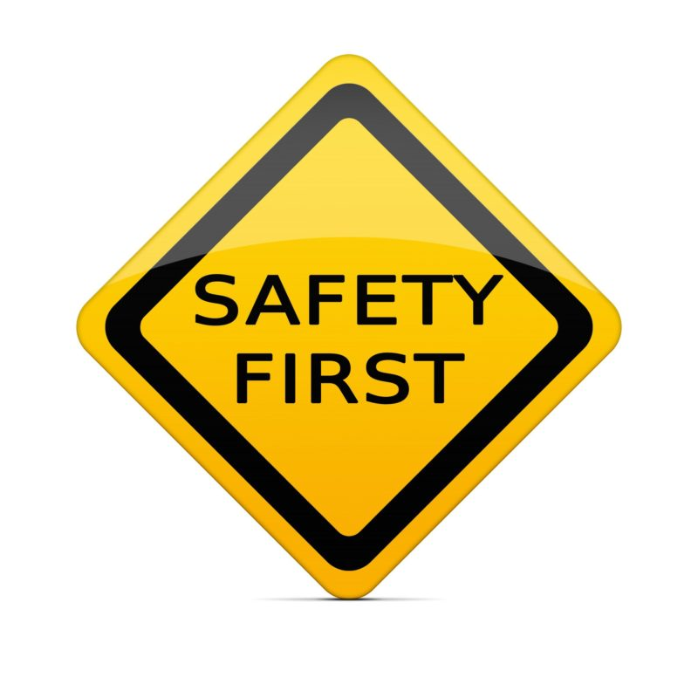

Health & Safety
As the design consultants we make sure that the principal contractor has an adequate risk assessment in place:
Fire proof structure
Fire exits
Smoke alarms
Aviation light
Sprinkler
Air ventilation

Slide 16
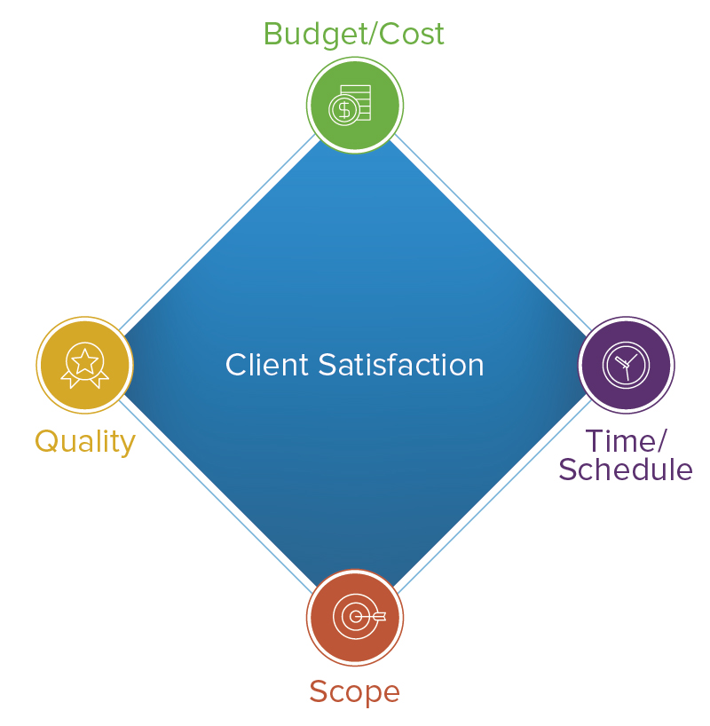
Short Summary
We believe we are offering the best ‘value for money’ to the client due to following reason:
Avoided construction in the underground zone (Time/Money)
Utilised a jump form construction system (Time/Money)
Top down construction method as opposed to Bottom Up (Time)
Re-used recycled construction materials (Money)

Slide 17
The End!
THANK YOU for listening!
Any questions?

